Slide 1

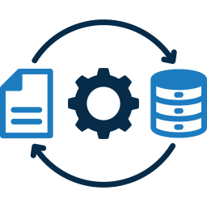
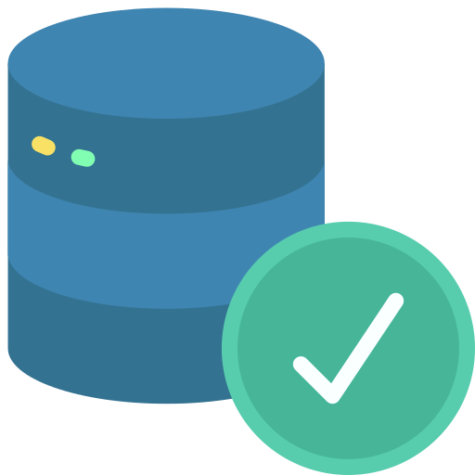
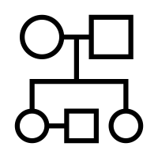
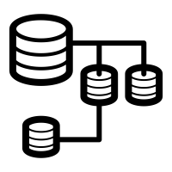








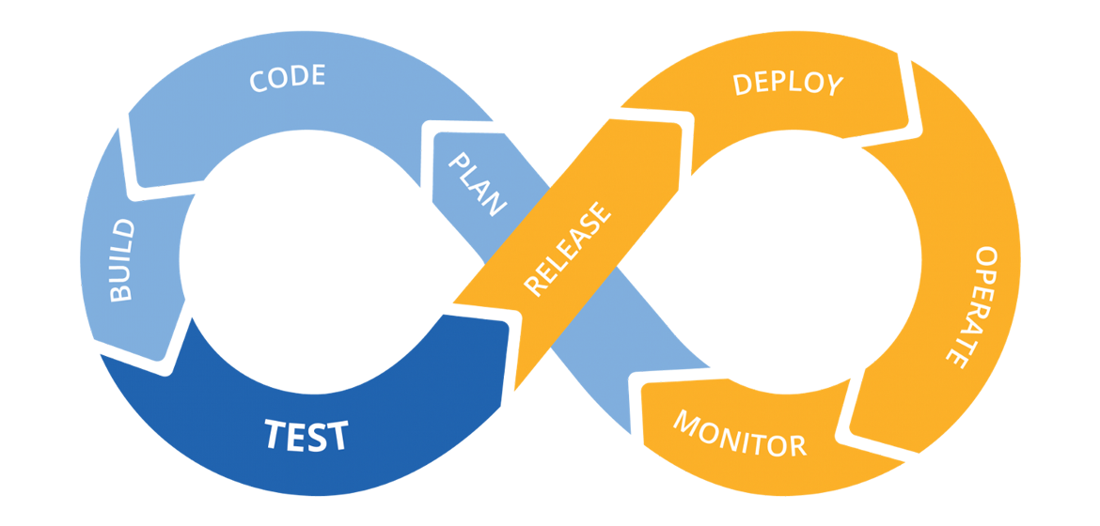





Data Management
Data Ingestion
Common Data Model
Data Transformation
Data Storage
Data Quality
Data Catalog
Data Lineage
Data Reporting
Data Operations
Documentation
Monitoring & Logging
Notifications
Testing
Ticketing
Observability
Foundation Enablers
AI ML
Robotic Process Automation
GenAi
Security
Orchestration
CI CD Migration
Cloud Integrations
Scalability
Flexibility
Auto Upgrades
Env & Git Setup
Semantic Layer
Notes:
Selected

Slide 2




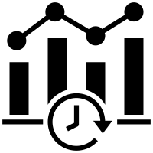

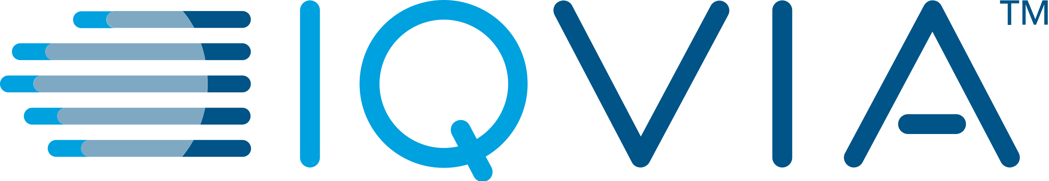



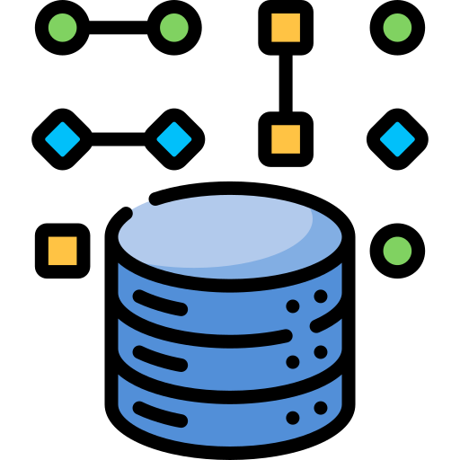






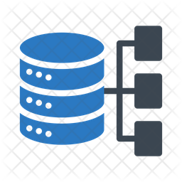
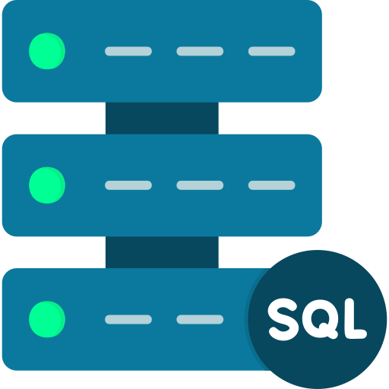
Next Gen Data
End Customers
Ingest
Process
Real Time Dashboard
Data Sources
Hot path
Speed / Real-time processing
Next Gen
Lambda Architecture
Streams / Live data
Real-Time Data Ingestion
Real-Time Data Analytics
Cold path
Batch processing
Cognitive Capabilities
BI Tool
AI/ML Capabilities
Unstructured Data
Videos, Images, Audio
Common Data Model
Telemetry Analytics for logs & time data
Semantic Models & Self-Serve BI
Data Catalog
Cognitive Search
Data Glossary
Semi-structured Data
Csv, Logs, Json, Xml
Ingestion Pipelines
Scheduled / Event based
Data Lake
Polyglot Persistence
Spark Technologies for big data
Data Driven Applications
Data Applications
Application
Relational Database
Structured
Cloud-based enterprise data Analytics Service (MPP)
SQL Technologies for EDW
Data Flow pattern
Data Lineage
Data Storage
Reporting
Data Governance & Quality
Foundation Enablers
Security
RPA
DevOps & GitHub
Orchestration
Flexibility
Auto Upgrades
Trinity Legacy Tools / Applications
Notes:
Selected

Slide 3



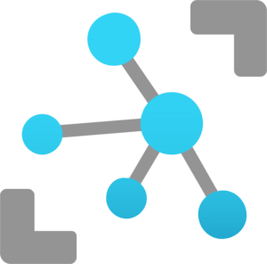


Ingestion : Real Time Data Ingestion - Live Data / Streams
Features :
Enables to automatically capture the streaming data in Event Hubs and continuous ingestion with low latency.
Establish bi-directional communication with billions of IoT devices.
Microsoft Services
Amazon Services
Google Services
Azure Event Hubs
Amazon Kinesis
Google Cloud PubSub
Azure IoT Hubs
Amazon IoT
Google IoT
Notes:
Selected

Slide 4



Ingestion : Data Ingestion Pipelines
Features :
Enables ingestion of data from unstructured, semi-structured & structured data.
Allow Schedule of pipeline based on event / time schedule.
Microsoft Services
Amazon Services
Google Services
Azure Functions
AWS Lambda
Google Functions
Notes:
Selected

Slide 5



Ingestion : Enterprise Level data analytics service
Features :
Cloud-based enterprise data warehouse (EDW) that uses massively parallel processing (MPP) to quickly run complex queries.
Microsoft Services
Amazon Services
Google Services
Azure Synapse Analytics
Amazon Redshift
Google BigQuery
Notes:
Selected

Slide 6


Data Storage : Data Lake
Features :
Scalable Storage
High Performance Polyglot storage (support different data storage approaches).
Microsoft Services
Amazon Services
Google Services
Azure Data Lake Storage
AWS S3
Google Cloud Storage
Notes:
Selected

Slide 7



Process : Real Time Data Analytics
Features :
Storage and analysis platforms that create insights from large quantities of data, or data that originates from many real time data sources and make decisions in real time.
Microsoft Services
Amazon Services
Google Services
Azure Stream Analytics
Amazon Kinesis Analytics
Google Analytics Data Stream
Notes:
Selected

Slide 8

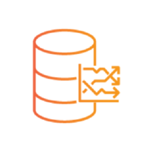
Process : Telemetric Analysis
Features :
Managed data analytics service for real-time analysis on large volumes of data streaming from applications, websites, IoT devices.
Microsoft Services
Amazon Services
Google Services
Azure Data Explorer Pool
Amazon Timeseries
Notes:
Selected

Slide 9


Process : Spark Technologies
Features :
Apache Spark-based analytics platform.
Microsoft Services
Amazon Services
Google Services
Databricks
EMR
Notes:
Selected

Slide 10
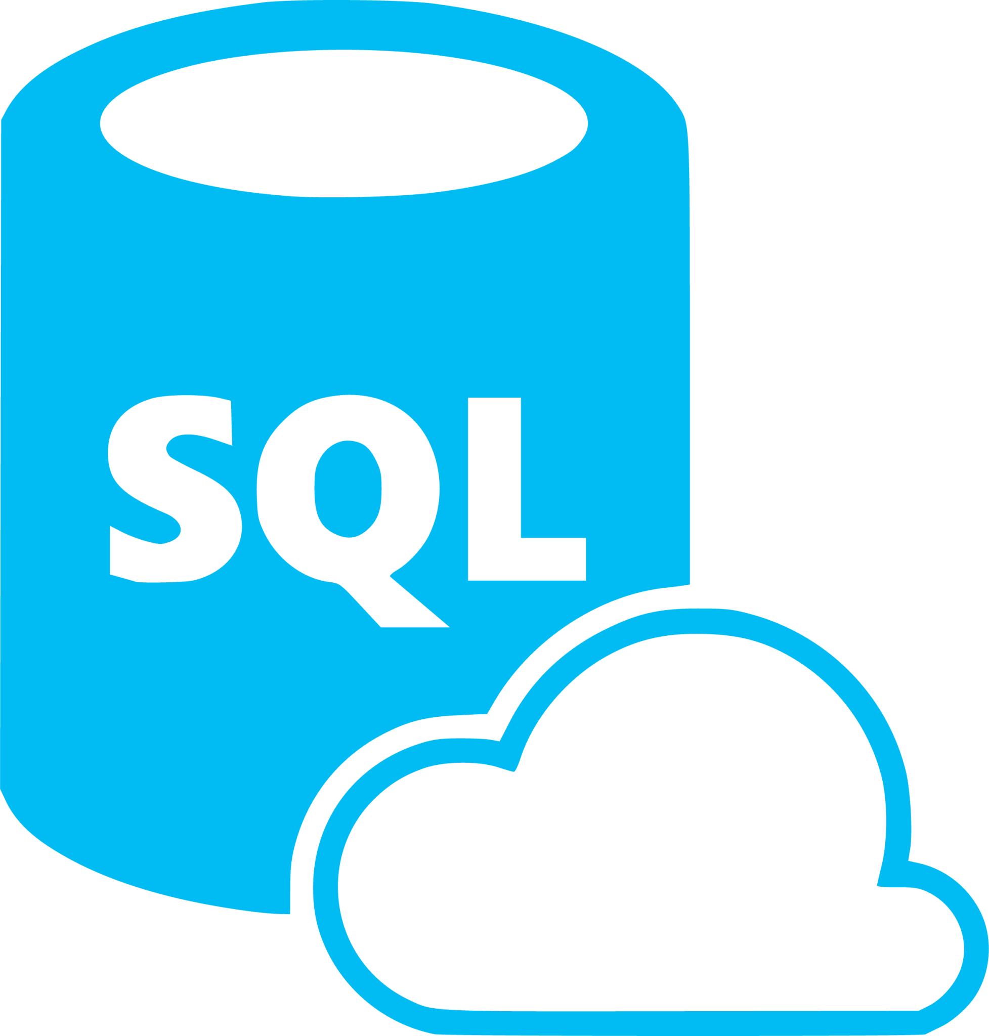


Process : SQL Technologies
Features :
Managed relational database services in which resiliency, scale and maintenance are primarily handled.
Caters processing of Enterprise Data Warehouse.
Microsoft Services
Amazon Services
Google Services
SQL Database
Amazon RDS
Google Cloud SQL
Notes:
Selected

Slide 11



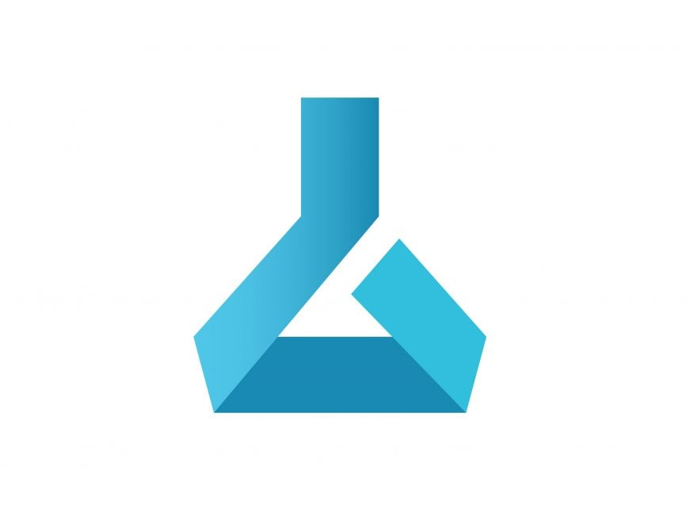


Next Gen : Cognitive , AI/ML Capabilities
Features :
Analyze at scale with more efficient predictive models.
Microsoft Services
Amazon Services
Google Services
Azure Cognitive Services
Amazon Rekognition
Google Cloud Vision
Azure Machine Learning
Amazon Machine Learning
Google Cloud ML Engine
Notes:
Selected

Slide 12



Reporting : BI Tool
Features :
Connect with disparate data sets, transform and clean the data into a data model and create charts or graphs to provide visuals of the data.
Microsoft Services
Amazon Services
Google Services
Power BI
Amazon QuickSight
Google Data Studio
Notes:
Selected

Slide 13



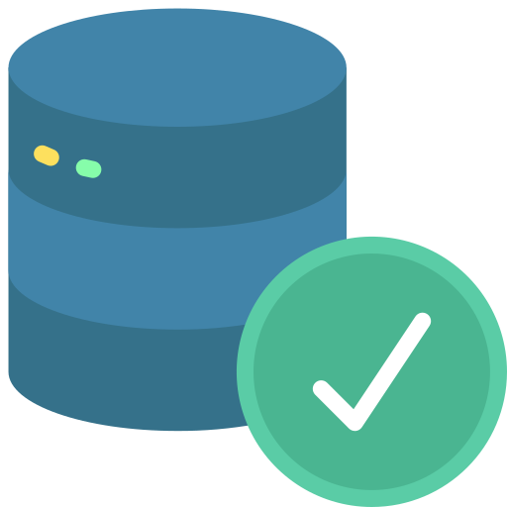
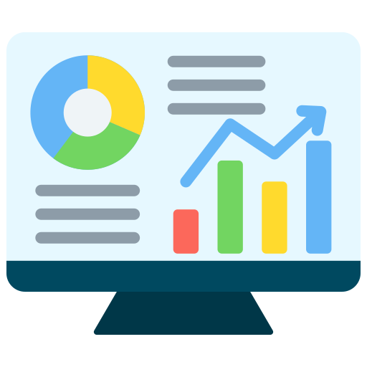
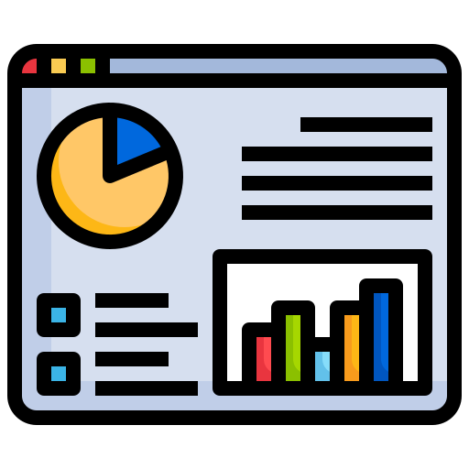

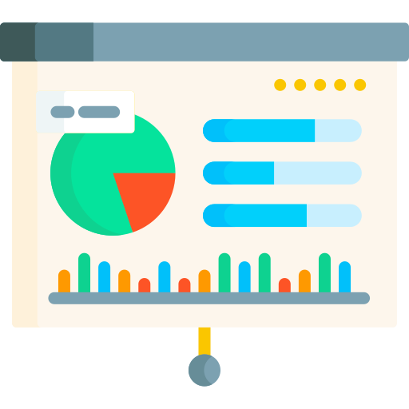


Data Sources
Ingest
Landing Zone
Process
Data Lake
Governance
Consumption
Dedicated & Secured Connections for 1st customer
Tenant Specific Isolation to avoid any accidental merging or conflicts.
Tenant Specific Views
Self Serve Dashboard
Tenant specific monitoring
Data Observability
Notifications Configurations
Source 1
Single Cloud Storage with logical partitions or folders for isolating each customer.
Multi Tenant Schema through
Tenant Id in each record.
Separate Schema to ensure data isolation.
Virtual Schema
C1
C2
Customer Control on Data
C3
Tenant 1 Specific Transformation
Source 2
Dedicated & Secured Connections for 2nd customer
Cloud Data Storage
C1
Data Quality
Source 3
C2
Data Lake
Polyglot Persistence
Tenant 2 Specific Transformation
View 1
Dedicated & Secured Connections for 3rd customer
Common Data Model
Data Security
Source 4
C1
Data Catalog
Cognitive Search
C2
Tenant 3 Specific Transformation
View 2
Source 5
Dedicated & Secured Connections for 4th customer
C1
Role Based Access Control
Data Lineage
Source 6
C2
Common Data Model
C3
Tenant 4 Specific Transformation
View 3
Data Encryption
Monitoring & Logging
Common Capability
Tenant Specific Capability
Notes:
Selected

Slide 14











SINGLE TENANT (Server 1, Different Instance)
Data Ingestion
Data Processing
(Prebuilt Reports/KPIs/Dashboards)
Data Sources
BI Visualizations 1
R
A
w
Cleansed
CDM
Semantic Layer
DB 1
DB 2
DB 3
BI Visualizations 2
Data Ingestion
(Common Data Model)
Unstructured Data
Videos, Images, Audio
BI Visualizations 3
NBA/
Analytics
Data Ingestion
DQ Framework
App 1
App 2
App 3
Semi-structured Data
Csv, Logs, Json, Xml
ORG1
ORG2
ORG3
App 1
App 2
App 3
ORG1
ORG2
ORG3
Relational Database
Structured
MULTI TENANT (Server 1, Same Instance)
Data Ingestion
Data Processing
(Prebuilt Reports/KPIs/Dashboards)
R
A
w
Semantic Layer
BI Visualizations
Cleansed
CDM
DB
Data Ingestion
(Common Data Model)
App 1
App 2
App 3
NBA/
Analytics
DQ Framework
Load balancer
App 1
App 2
App 3
Data Ingestion
ORG1
ORG2
ORG3
ORG1
ORG2
ORG3
Foundation Enablers
Data Migrator
Data Comparator
Security
RPA
DevOps & GitHub
Orchestration
Flexibility
Auto Upgrades
Code/Script Converter
Trinity Legacy Tools / Applications

Slide 15
SINGLE TENANT (Server 1, Different Instance)
Data Ingestion
Data Processing
(Prebuilt Reports/KPIs/Dashboards)
Data Sources
BI Visualizations 1
R
A
w
Cleansed
CDM
Semantic Layer
DB 1
DB 2
DB 3
BI Visualizations 2
Data Ingestion
(Common Data Model)
Unstructured Data
Videos, Images, Audio
BI Visualizations 3
NBA/
Analytics
Data Ingestion
DQ Framework
App 1
App 2
App 3
Semi-structured Data
Csv, Logs, Json, Xml
ORG1
ORG2
ORG3
App 1
App 2
App 3
ORG1
ORG2
ORG3
Relational Database
Structured
Trinity Product/Tools
TERRA - EXTRACTOR
IRIS
NBA
TERRA - Data Lineage
TERRA - DQM
TERRA - Data Catalog
Foundation Enablers
Data Migrator
Data Comparator
Security
RPA
DevOps & GitHub
Orchestration
Flexibility
Auto Upgrades
Code/Script Converter
Trinity Legacy Tools / Applications

Slide 16
Key Benefits
Cost Efficient
Scalability
Streamlined Updates and Maintenance
Resource Optimization
Customizations & Flexibility
Data Security Enhancement
Faster Go-To Market
20 point, bold current section

Slide 17
Key Aspects
Tenant Isolation
Onboarding Process
Tenant Configuration
20 point, bold current section

Slide 18
Best Practices
Use 16 point blue, non-bolded, non-italicized 1.2 point character spacing for 2nd line takeaway after 1st line title
Scalability
Isolated Data & Security
Monitor Performance & Resource Utilization
Automation & Orchestration

